Slide 1


Work In Progress
Presented By
Darshan K S
Research Assistant, MIRC
DSI

Slide 2
Content
16 channel Head coil
Head former
Dielectric property of brain at 63.8MHz
Single loop receive coil element
Coil placement and bench testing
LNA – preamplifier
List of LNA from different vendors
LNA circuit schematic
Simulation results

Slide 3
Design criteria for head coil
Dielectric property of material used for head former
Coil dimension
Number of coil element
Geometrical arrangement
Decoupling the coil element

Slide 4
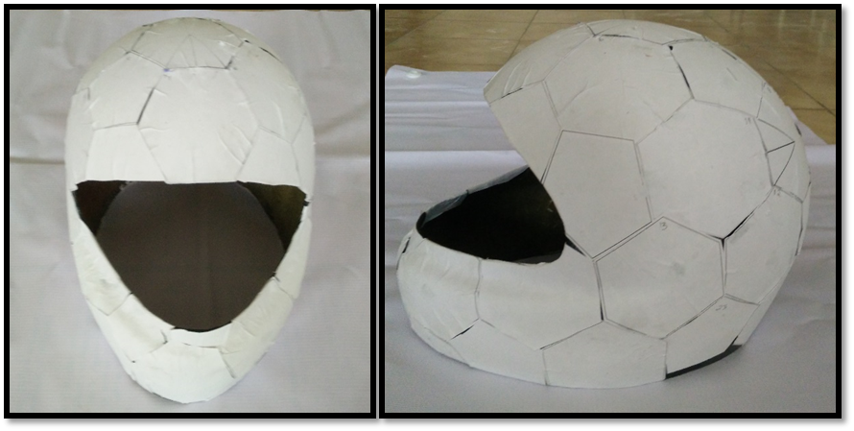
Head former
Pentagon Tile
Hexagon Tile
Dimension of the head former
Anterior to Posterior = 26cm
Left to right = 20cm
Height = 18cm
Required material property
High permittivity and Low conductivity
Figure: Geometry arrangement of 16 channel layout
MIRC lab Material used for head former | Industries/other research lab Material used for head former
Polycarbonate = 2.9 | Acrylonitrile Butadiene Styrene = 2.8 to 3.8
Polystyrene or Polypropylene = 2.2 to 2.36 | Polyvinyl Alcohol

Slide 5
Dielectric property of brain at 63.8MHz
Brain Gray matter
Conductivity = 0.081558 S/m
Permittivity = 8.342*E6
Brain white matter
Conductivity = 0.055477 S/m
Permittivity = 3.56*E6
C. Gabriel, Compilation of the dielectric properties of body tissues at RF and microwave frequencies, Air Force materiel command, Brooks Air Force Base, TX, AL/OE-TR-1996-0037, 1996.
Yang, Qing X., et al. "Analysis of wave behavior in lossy dielectric samples at high field." Magnetic resonance in medicine 47.5 (2002): 982-989.

Slide 6
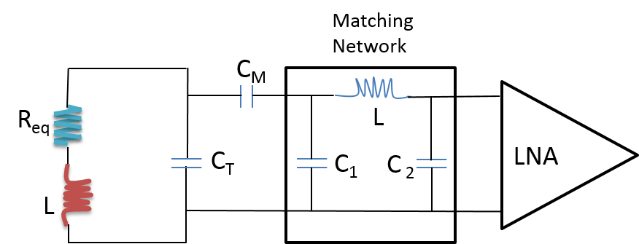
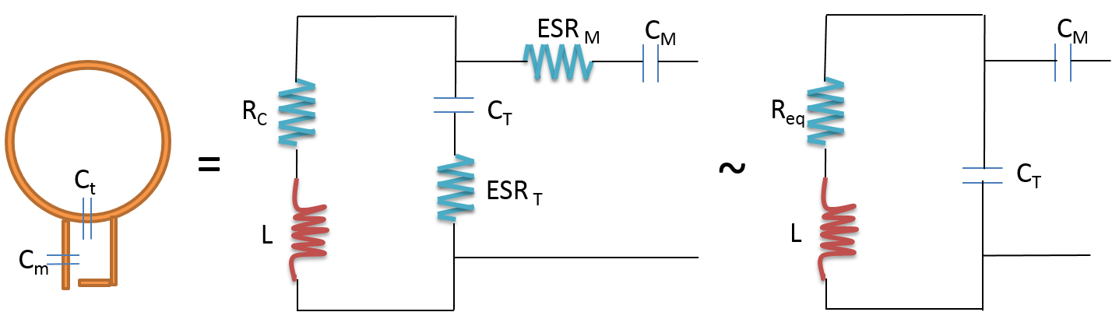
Single loop Receive element
Figure: Coil tuned to 63.8MHz
Figure: Matching network and preamplifier
Keil, Boris, et al. "A 64‐channel 3T array coil for accelerated brain MRI." Magnetic resonance in medicine 70.1 (2013): 248-258.

Slide 7
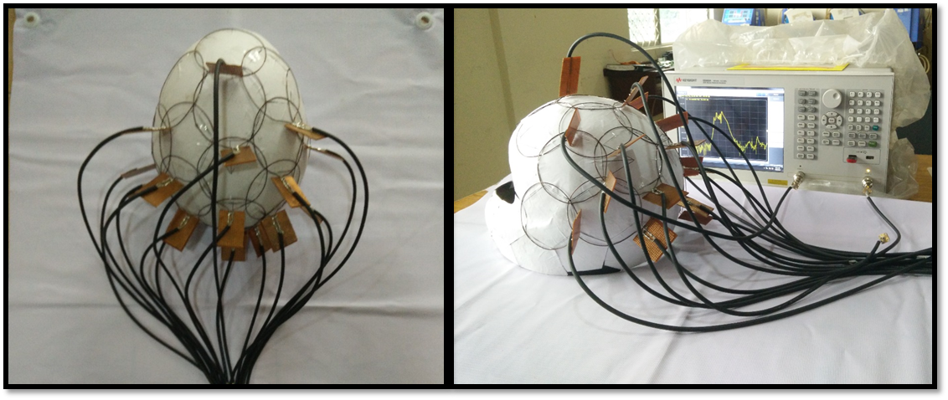
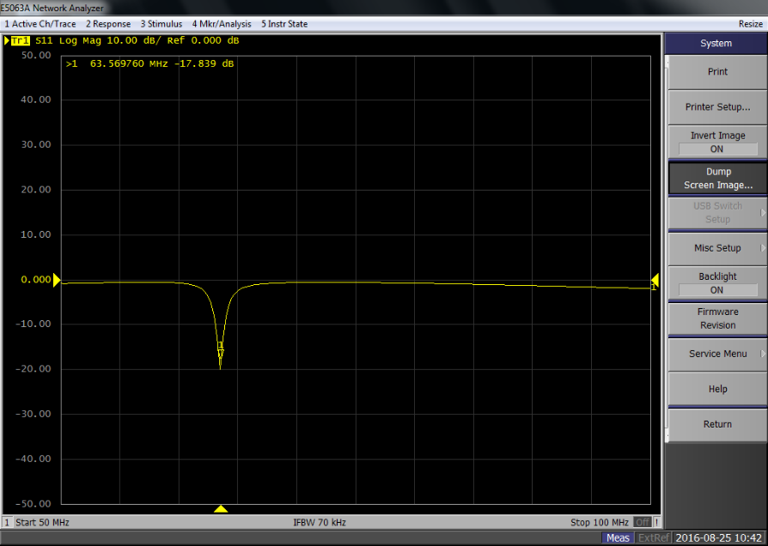
Coil placement and bench testing
Figure: 16 element placement and its characterization
Figure: Frequency response S11 measurement
Coils | 1 | 2 | 3 | 4 | 5 | 6 | 7 | 8 | 9 | 10 | 11 | 12 | 13 | 14 | 15 | 16
S₁₁ (dB) | -16 | -20 | -18 | -18 | -22 | -20 | -14 | -15 | -16 | -18 | -14 | -15 | -16 | -17 | -16 | -18

Slide 8
List of LNA
SI No | Company | Part number | Noise Figure (dB) | Frequency
1 | e2v | DA5975-064 | 0.5 | 63.8MHz
2 | Texas Instrument | TL5500 | 0.5 | 63.8MHz and 128MHz
3 | RF Bay | LNA-545 | 1.9 | 10kHz – 500MHz
4 | RF Bay | LNA-650 | 2.2 | 30kHz – 600MHz
5 | RF Bay | LNA-1440 | 2.7 | 10kHz – 1400MHz
6 | Coaxial LNA | ZFL-500LN+ | 2.9 | 0.1 – 500MHz
Components used
AsGa-FET
Transistor – 2N1711
Simulation tool
NI-multisim
TINA

Slide 9
LNA: Circuit Schematic
To achieve Gain and bandwidth
Output impedance
match
Output
Input
(MRI Signal)
To achieve optimum
Noise figure
Preamplifier input
Impedance match to 50ohm coil output impedance
Reference:
Cao, XueMing, et al. "The design of a low-noise preamplifier for MRI." Science China Technological Sciences 54.7 (2011): 1766-1770.

Slide 10
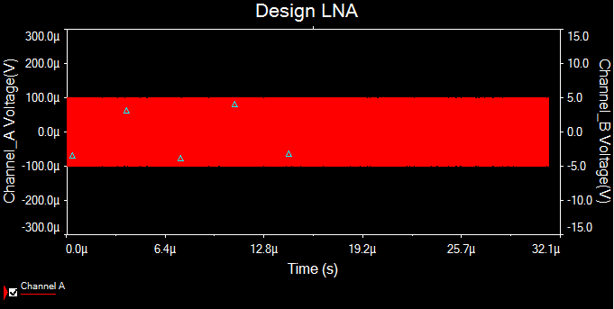
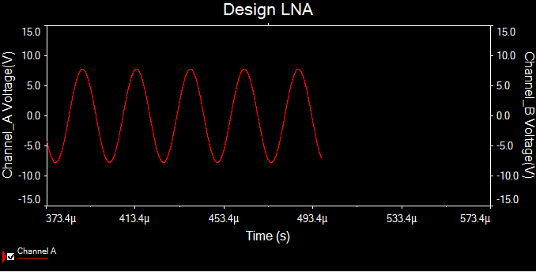
Simulation results
Input voltage: 100uV
Output voltage: 5.5V
Figure: Input signal
Figure: Output signal

Slide 11
Thank you

